Slide 1
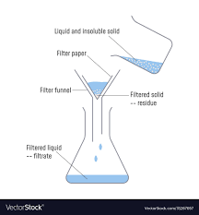
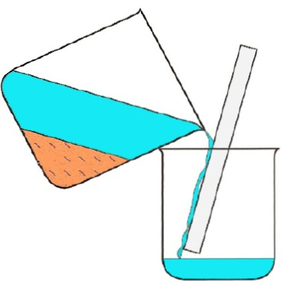
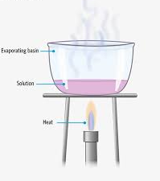
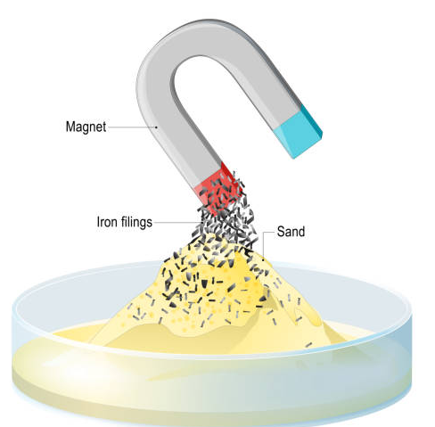
The process of separating using the size of the particles
filtration
decantation
The process of separating using density
The process of separating a soluble solid from a liquid using boiling point
evaporation
The process of separating a mixture using magnetic properties
magnetic separation
The liquid that passes through the filter during filtration
filtrate

Slide 2
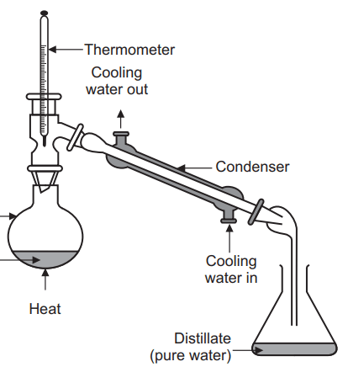
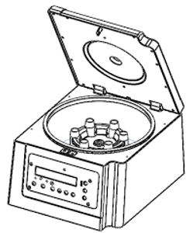
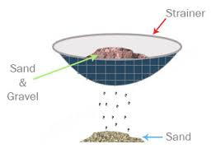
The parts of the mixture that do not pass through the filter during filtration
residue
The process of separating two or more liquids using boiling point
distillation
The process of separating mixtures by spinning them very quickly
centrifuge
The process of separating solids using particle size
sieving

